Slide 1
Advanced Data Analytics: Course Introduction
Professor Ian Nabney
ian.nabney@bristol.ac.uk

Slide 2
Overview
Structure of the unit
This unit extends the material taught in the co-requisite unit 'Introduction to Data Analytics' by giving students a solid grounding in contemporary advanced machine learning. The unit also covers some more advanced techniques and analytical approaches to information visualisation.
In visual analytics, such methods serve to as useful tools to change the data representation, e.g. through dimensionality reduction, or as a way of analysing visual data) in a framework of statistical pattern recognition. Machine learning topics covered by this unit include: principles of Statistical Pattern Recognition (probabilistic models for data, curse of dimensionality generalisation error, bias-variance dilemma); linear models (Probabilistic Principal Component Analysis; Discriminant Analysis); generalised dissimilarity mappings and neighbour embedding techniques; Gaussian Processes; latent variable models (Gaussian Mixture Models, Generative Topographic Mapping and Gaussian Process Latent Variable Model); Bayesian model regularisation and combination; feature selection; challenges of large datasets and potential solutions.
In text analytics, such methods serve to produce powerful analyses that traditional methods fail to deliver using learning, along with crowd-sourced data annotation.
Data visualisation and machine learning

Slide 3
Week | Asynchronous Content | Lectorial/Discussion | Lab Class
1 | Topographic dimensionality reduction. Dissimilarity measures (stress etc.) and models for dimensionality reduction (Neuroscale, SNE). | Error analysis | Application of dissimilarity-measure based models for data projection
2 | Statistical pattern recognition. Principles of statistical modelling, likelihood, curve fitting, model selection. Linear models for dimensionality reduction (PCA) | Information theory | Application of linear data projection
3 | Latent variable models. Density estimation: kernel estimation, Gaussian mixture models, probabilistic PCA, Generative Topographic Mapping | Evaluation of dimensionality reduction methods | GTM and variants for data projection
4 | Advanced Information Visualisation 1: Task Abstraction, Visual Queries, Validation | Visual queries: example analysis | Tableau: data sources and calculations
5 | Advanced Information Visualisation 2: Structuring Space, Multiple Views | Visual thinking and design critiques | Tableau: data joins and advanced calculations
- | READING WEEK
6 | Advanced Information Visualisation 3: Colour perception and advanced mapping marks | Visual thinking conclusions | Tableau: advanced interaction
7 | Bayesian methods in machine learning: principles, sampling, basic variational methods (and application to Gaussian mixture models) | Optimisation algorithms | Variational Bayesian GMM for robust density modelling
8 | Gaussian Processes and Gaussian Process Latent Variable Models | Summary and overview of machine learning | Coursework
9 | Advanced Text Analytics 1: Skipgram word embeddings; neural text classifiers, RNNs, LSTMs | Neural networks for text analytics | Jupyter notebook: neural text classifier
- | SPRING VACATION
10 | Advanced Text Analytics 2: Self-attention, transformers, transfer learning; question answering | Large language models and transfer learning | Jupyter notebook: pretrained language models
11 | Advanced Text Analytics 3: continuing advanced text analytics 1 and 2; data annotation | Data annotation | Completing lab report based on Jupyter notebooks

Slide 4
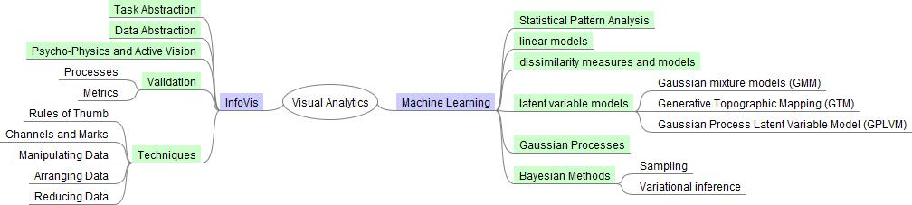
Course Mind Map: Visual Analytics

Slide 5
Data projection
The goal is to project data to a lower-dimensional space (usually 2d or 3d) while preserving as much information or structure as possible.
Once the projection is done standard information visualisation methods can be used to support user interaction. These may need to be modified for Big Data.
The quantity and complexity of many datasets means that simple visualisation methods, such as Principal Component Analysis, are not very effective.

Slide 6
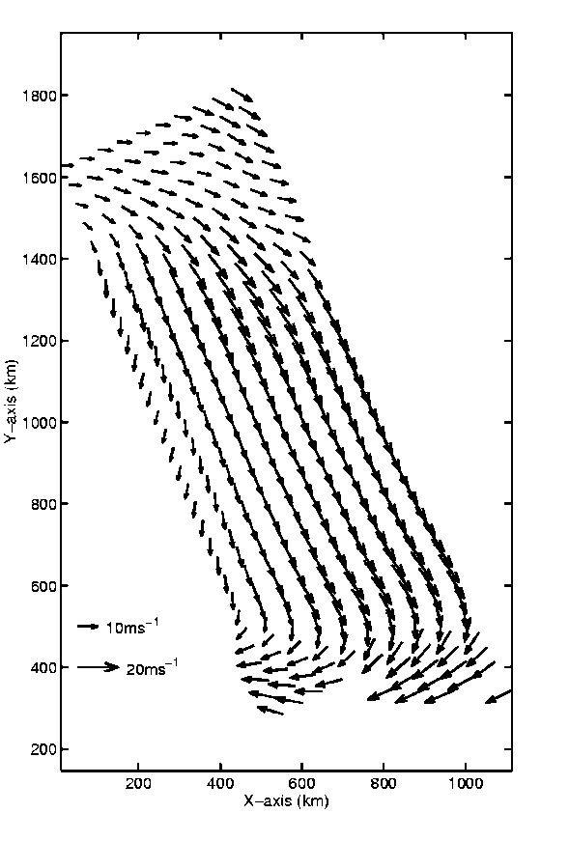
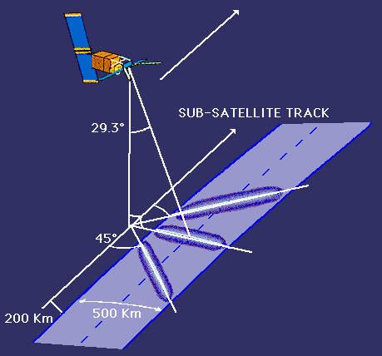
Hidden Knowledge
Understanding the vast quantities of data that surround us is a real challenge
We can understand more of it with help. Machine learning is the computer-based generation of models from data.
Parameters in the model express the hidden connection between inputs and predictions.

Slide 7
Uncertainty
Doubt is not a pleasant condition, but certainty is absurd.
Voltaire
Real data is noisy.
We are forced to deal with uncertainty, yet we need to be quantitative.
The optimal formalism for inference in the presence of uncertainty is probability theory.
We assume the presence of an underlying regularity to make predictions.
Bayesian inference allows us to reason probabilistically about the model as well as the data.

Slide 8
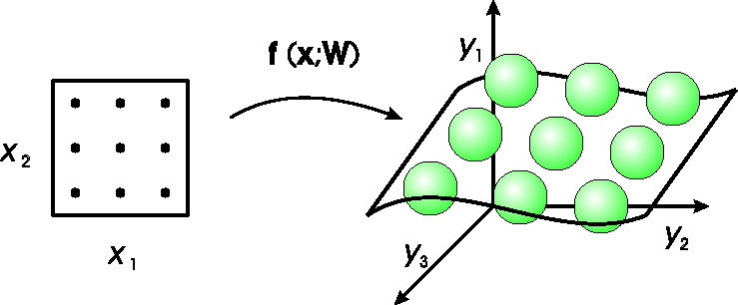
Generative Topographic Mapping
Mapping from latent space to data space
A thick rubber sheet studded with tennis balls. GTM defines p(y|x;W); use
Bayes’ theorem to compute p(x|y*;W) for a given point y* in data space.

Slide 9
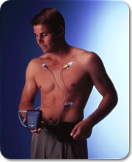
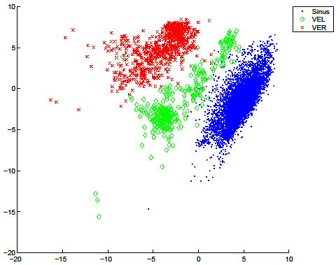
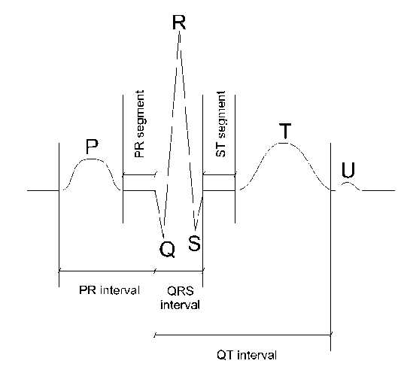
ECG Analysis
What can we learn from this?

Slide 10
Interactive Visualisation Tool

Slide 11
Conclusions
We need to understand the vast quantities of data that surround us; visualisation and machine learning can help us in that task.
Models can be used to uncover the hidden meanings of data.
A probabilistic approach to modelling data provides many benefits.
It is a multivariate, multi-skilled, collaborative effort.

